Slide 1








Workshop in XGBOOST and Multitemporal DETER Data for Deforestation Forecasting
Laura E. Cué La Rosa¹, Felipe Ferrari², Francisco Gilney Silva Bezerra³,Rodrigo Antônio de Souza⁴, Raian Vargas Maretto⁵,Ana Paula Dutra de Aguiar³⁶, Lubia Vinhas³, Patrick Nigri Happ², Raul Queiroz Feitosa²
1 Wageningen University & Research, Netherlands
2 Pontifical Catholic University of Rio de Janeiro, Brazil
3 National Institute for Space Research, Brazil
4 Brazilian Institute of Environmental and Renewable Natural Resources, Brazil
5 University of Twente, Netherlands
6 Stockholm Resilence Center, Stockholm University, Sweden

Slide 2





Objectives
Method
Environment Setup
Data loading
Train and Evaluation
Interpretability

Slide 3

Objectives
Method
Environment Setup
Data loading
Train and Evaluation
Interpretability
Project scope: Produce biweekly deforestation risk maps incorporating data on forest degradation and deforestation from the DETER System and a wide range of socio-political and economic factors.
Main Objectives of the Workshop
Understand and Set Up the Technical Environment
Explore the Code Pipeline for Spatiotemporal Modeling
Model train and evaluation
Inference and Generate Predictive Maps
Enable Operationalization and Reproducibility

Slide 4








Objectives
Method
Environment Setup
Data loading
Train and Evaluation
Interpretability
Data
Model
Decision Forest
Neural Network
Risk Map

Slide 5

Objectives
Method
Environment Setup
Data loading
Train and Evaluation
Interpretability
Data
XGBoost
high performance on
sparse data
requires less data for accurate results
RESIDUAL
RESIDUAL
Model
higher interpretability
SUM
requires more
modest computational resources
XGBoost builds an ensemble of decision trees rooted in the gradient-boosting paradigm
Decision Forest
Neural Network
Risk Map

Slide 6


Objectives
Method
Environment Setup
Data loading
Train and Evaluation
Interpretability
Step-by-Step: Conda + Jupyter + Packages
🧱 1. Install Required Tools (if not already installed)
Download Conda from: https://www.anaconda.com/download

Slide 7
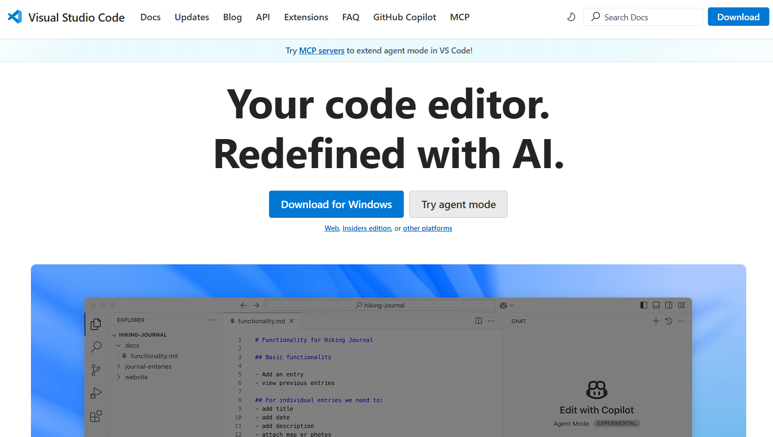
Objectives
Method
Environment Setup
Data loading
Train and Evaluation
Interpretability
Step-by-Step: Conda + Jupyter + Packages
🧱 1. Install Required Tools (if not already installed)
Download Conda from: https://www.anaconda.com/download
Download VS Code from: https://code.visualstudio.com/
Run the installer and follow the default installation steps

Slide 8
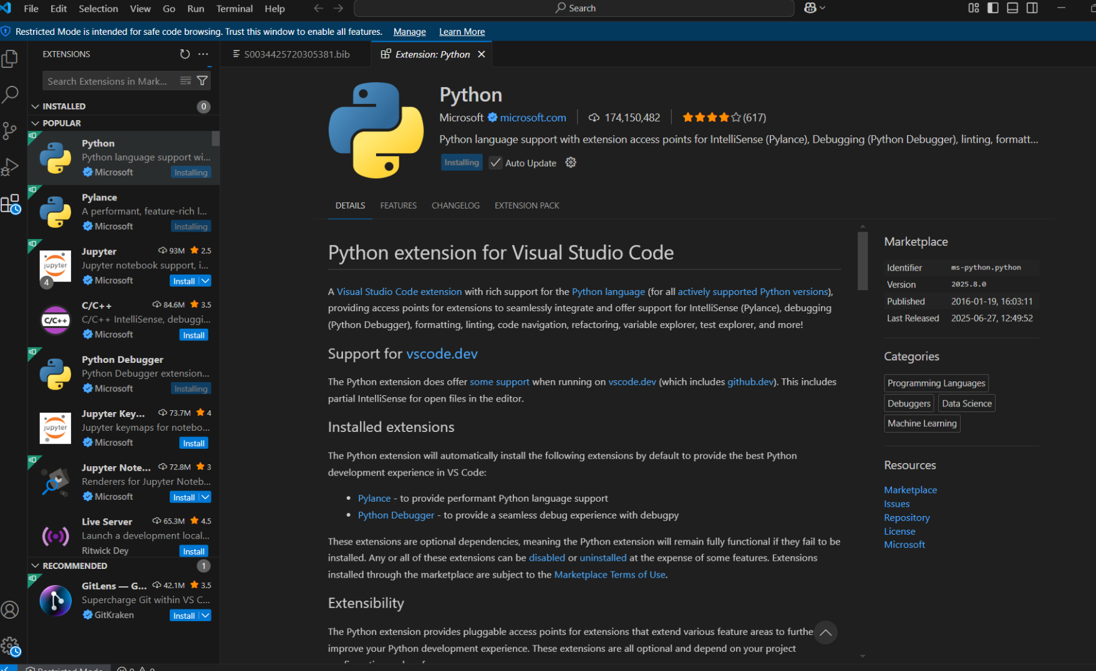
Objectives
Method
Environment Setup
Data loading
Train and Evaluation
Interpretability
Step-by-Step: Conda + Jupyter + Packages
🧱 1. Install Required Tools (if not already installed)
Download Conda from: https://www.anaconda.com/download
Download VS Code from: https://code.visualstudio.com/
Install Python Extension
1. Click the Extensions icon in the Activity Bar (or press Ctrl+Shift+X)
2. Search for "Python" (by Microsoft)
3. Click "Install“
Install Jupyter Notebook Extension
1. Click the Extensions icon in the Activity Bar (or press Ctrl+Shift+X)
2. Search for “Jupyter" (by Microsoft)
3. Click "Install"

Slide 9
Objectives
Method
Environment Setup
Data loading
Train and Evaluation
Interpretability
Step-by-Step: Conda + Jupyter + Packages
🧱 1. Install Required Tools (if not already installed)
🔧 2. Create and Configure a Conda Environment
Open Anaconda Prompt or a terminal and type

Slide 10
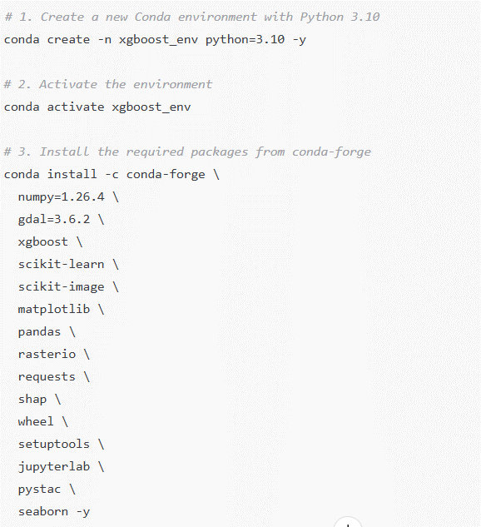
Objectives
Method
Environment Setup
Data loading
Train and Evaluation
Interpretability
Step-by-Step: Conda + Jupyter + Packages
🧱 1. Install Required Tools (if not already installed)
🔧 2. Create and Configure a Conda Environment
Open Anaconda Prompt or a terminal and type
Notes:
# 1. Create a new conda environment
conda create -n xgboost_env python=3.10 -y
# 2. Activate the environment
conda activate xgboost_env
# 3. Install packages
conda install -c conda-forge numpy=1.26.4 gdal=3.6.2 xgboost scikit-learn scikit-image matplotlib pandas rasterio requests shap wheel setuptools jupyterlab pystac seaborn -y

Slide 11
Objectives
Method
Environment Setup
Data loading
Train and Evaluation
Interpretability
Step-by-Step: Conda + Jupyter + Packages
🧱 1. Install Required Tools (if not already installed)
🔧 2. Create and Configure a Conda Environment
🧭 3. Open the Project in VS Code
Launch VS Code
Open your project folder: File → Open Folder → Select the project directory

Slide 12
Objectives
Method
Environment Setup
Data loading
Train and Evaluation
Interpretability
Step-by-Step: Conda + Jupyter + Packages
🧱 1. Install Required Tools (if not already installed)
🔧 2. Create and Configure a Conda Environment
🧭 3. Open the Project in VS Code
⚙️ 4. Set VS Code Python Interpreter
Press Ctrl+Shift+P
Type: Python: Select Interpreter
Select: xgboost_env (conda)

Slide 13
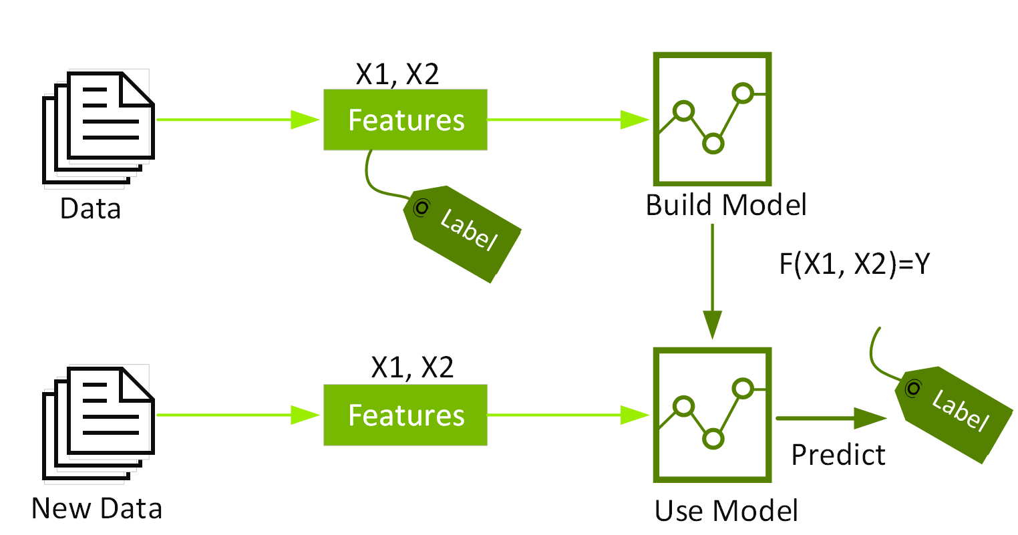
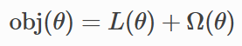
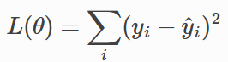
Objectives
Method
Environment Setup
Data loading
Train and Evaluation
Interpretability
What is XGBoost?
Supervised machine learning uses algorithms to train a model to find patterns in a dataset with labels and features and then uses the trained model to predict the labels on a new dataset’s features.
What Is XGBoost and Why Does It Matter? | NVIDIA Glossary

Slide 14
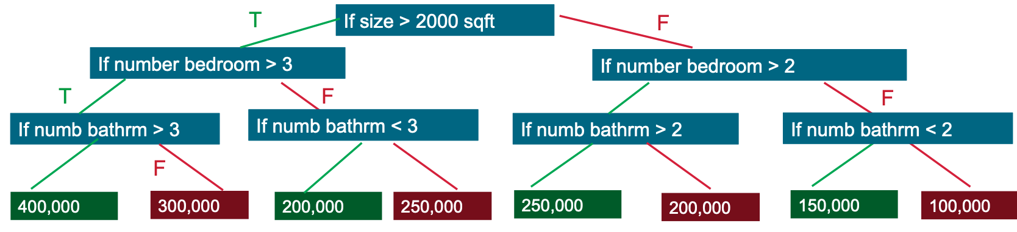
Objectives
Method
Environment Setup
Data loading
Train and Evaluation
Interpretability
What is XGBoost?
Predicts the label by evaluating a tree of if-then-else true/false feature questions
Estimates the minimum number of questions needed to assess the probability of making a correct decision
Can be used for classification to predict a category, or regression to predict a continuous numeric value
What Is XGBoost and Why Does It Matter? | NVIDIA Glossary

Slide 15
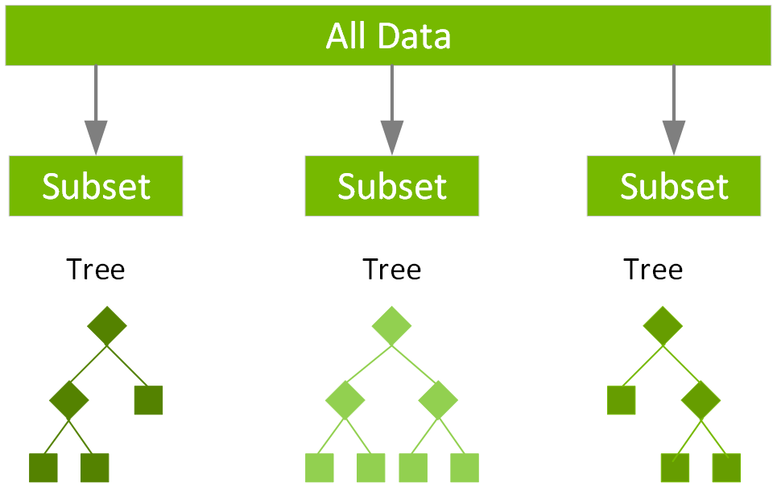
Objectives
Method
Environment Setup
Data loading
Train and Evaluation
Interpretability
What is XGBoost?
Ensembles -> combine the decisions from multiple models to improve the overall performance.
What Is XGBoost and Why Does It Matter? | NVIDIA Glossary

Slide 16
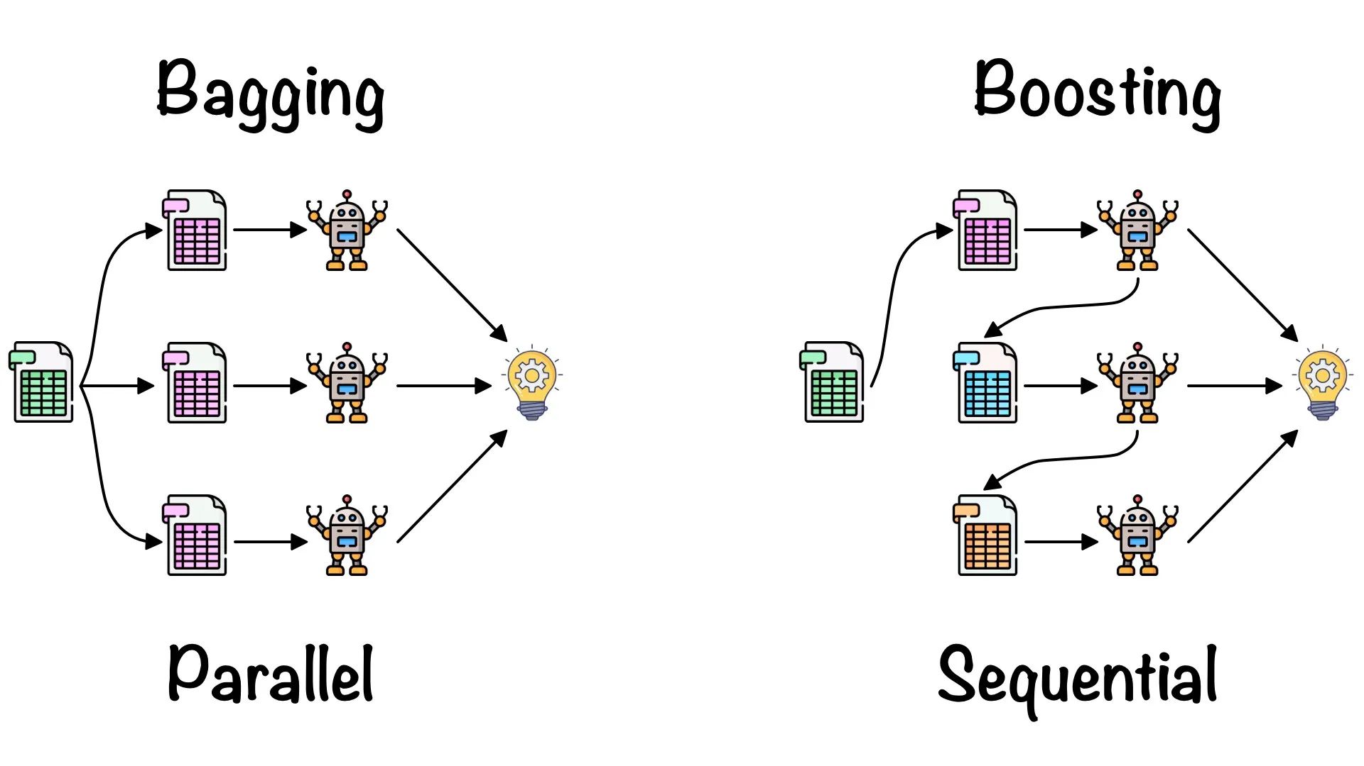
Objectives
Method
Environment Setup
Data loading
Train and Evaluation
Interpretability
What is XGBoost?
Ensembles -> combine the decisions from multiple models to improve the overall performance.
BAGGING -> subsetting the data and aggregating the results (e.g, Random Forest)
BOOSTING -> sequential, each subsequent model attempts to correct the errors of the previous model.
XGBoost: A BOOSTING Ensemble. Does it really work as the name… | by Rishabh Kesarwani | AlmaBetter | Medium
What Is XGBoost and Why Does It Matter? | NVIDIA Glossary

Slide 17
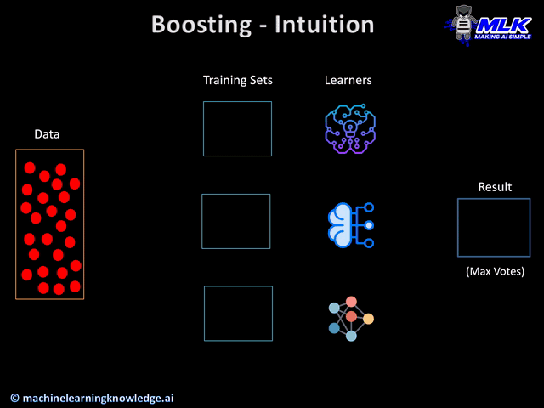
Objectives
Method
Environment Setup
Data loading
Train and Evaluation
Interpretability
What is XGBoost?
GRADIENT BOOSTING
Improving a single weak model by combining it with a number of other weak models -> Collectively strong model
Each decision tree within the committee is specifically trained to address the residual errors propagated by the preceding trees
What Is XGBoost and Why Does It Matter? | NVIDIA Glossary

Slide 18

Objectives
Method
Environment Setup
Data loading
Train and Evaluation
Interpretability
What is XGBoost?
GRADIENT BOOSTING
Improving a single weak model by combining it with a number of other weak models -> Collectively strong model
Each decision tree within the committee is specifically trained to address the residual errors propagated by the preceding trees
The gradient of the loss function guides this correction
The training involves assigning weights to each tree based on their contribution
What Is XGBoost and Why Does It Matter? | NVIDIA Glossary

Slide 19
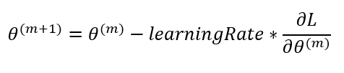
Objectives
Method
Environment Setup
Data loading
Train and Evaluation
Interpretability
What is XGBoost?
GRADIENT BOOSTING
In order to minimize the loss function we take the derivative of the loss function and add the negative of this value to the weight scaled by some learning rate to achieve a more accurate model this is process is repeated until convergence.
What Is XGBoost and Why Does It Matter? | NVIDIA Glossary

Slide 20
Objectives
Method
Environment Setup
Data loading
Train and Evaluation
Interpretability
XGBoost is a scalable and highly accurate implementation of gradient boosting
GRADIENT BOOSTING
In order to minimize the loss function we take the derivative of the loss function and add the negative of this value to the weight scaled by some learning rate to achieve a more accurate model this is process is repeated until convergence.
What Is XGBoost and Why Does It Matter? | NVIDIA Glossary

Slide 21
Objectives
Method
Environment Setup
Data loading
Train and Evaluation
Interpretability
Why XGBoost?
Regularization: penalize complex models through both L1 and L2 regularization. Regularization helps in preventing overfitting.
Handling sparse data: sparsity-aware split finding algorithm to handle different types of sparsity patterns in the data.
Weighted quantile sketch: Most existing tree-based algorithms can find the split points when the data points are of equal weights (using a quantile sketch algorithm). However, they are not equipped to handle weighted data. XGBoost has a distributed weighted quantile sketch algorithm to effectively handle weighted data
Block structure for parallel learning: make use of multiple cores on the CPU.
XGBoost: A BOOSTING Ensemble. Does it really work as the name… | by Rishabh Kesarwani | AlmaBetter | Medium

Slide 22
Objectives
Method
Environment Setup
Data loading
Train and Evaluation
Interpretability
Hyperparameters in XGBoost
Hyperparameters
General
Booster
Learning Task
Command Line

Slide 23
Objectives
Method
Environment Setup
Data loading
Train and Evaluation
Interpretability
Hyperparameters in XGBoost
Hyperparameters
General
Booster
Learning Task
Command Line

Slide 24
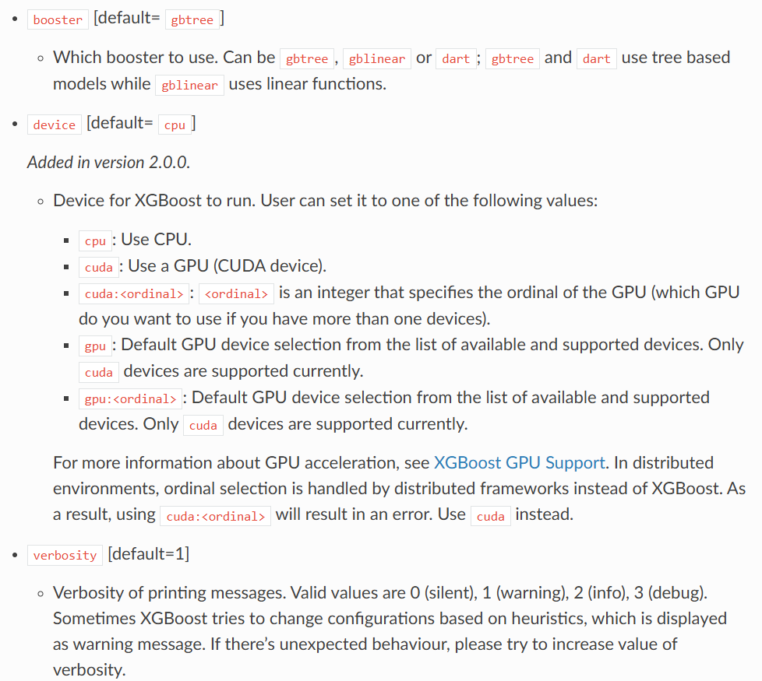
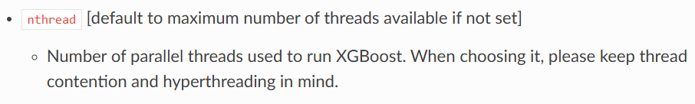
Objectives
Method
Environment Setup
Data loading
Train and Evaluation
Interpretability
Hyperparameters in XGBoost
General

Slide 25
Objectives
Method
Environment Setup
Data loading
Train and Evaluation
Interpretability
Hyperparameters in XGBoost
Hyperparameters
General
Booster
Learning Task
Command Line

Slide 26
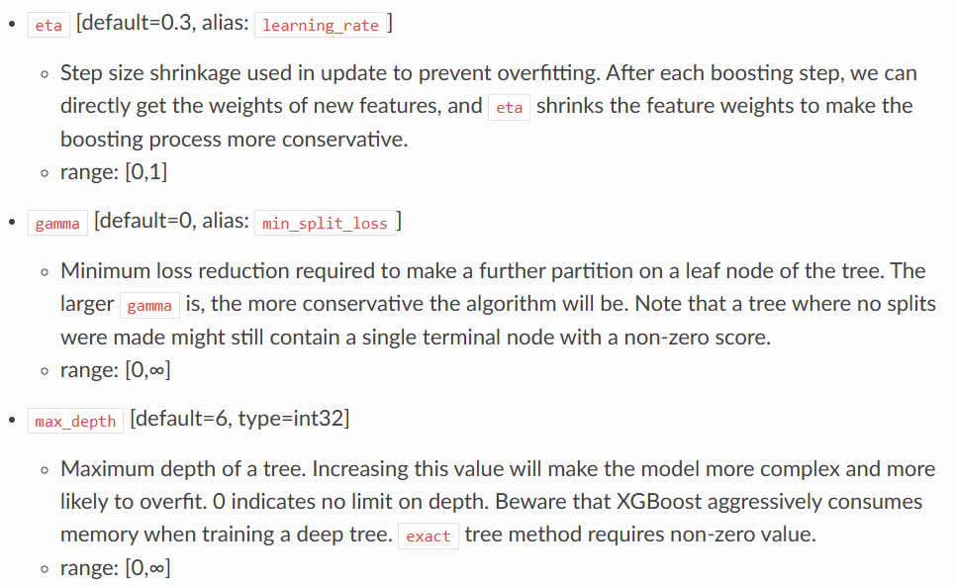
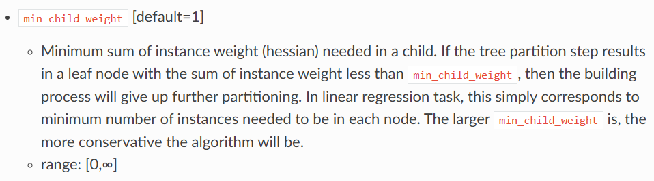
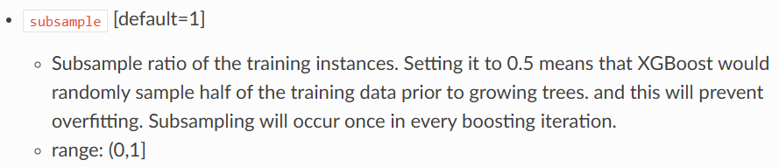
Objectives
Method
Environment Setup
Data loading
Train and Evaluation
Interpretability
Hyperparameters in XGBoost
Booster

Slide 27
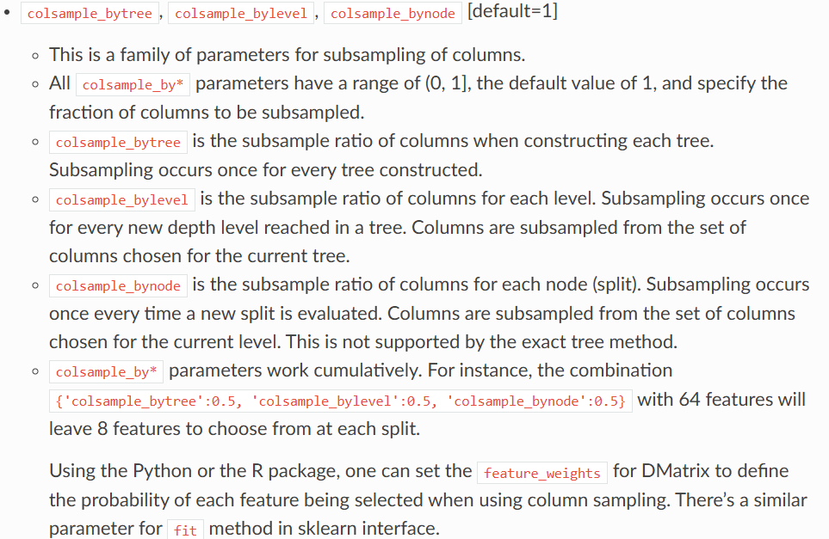
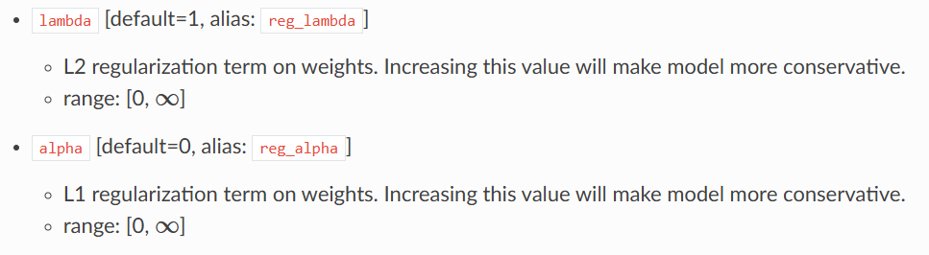
Objectives
Method
Environment Setup
Data loading
Train and Evaluation
Interpretability
Hyperparameters in XGBoost
Booster

Slide 28
Objectives
Method
Environment Setup
Data loading
Train and Evaluation
Interpretability
Hyperparameters in XGBoost
Hyperparameters
General
Booster
Learning Task
Command Line

Slide 29
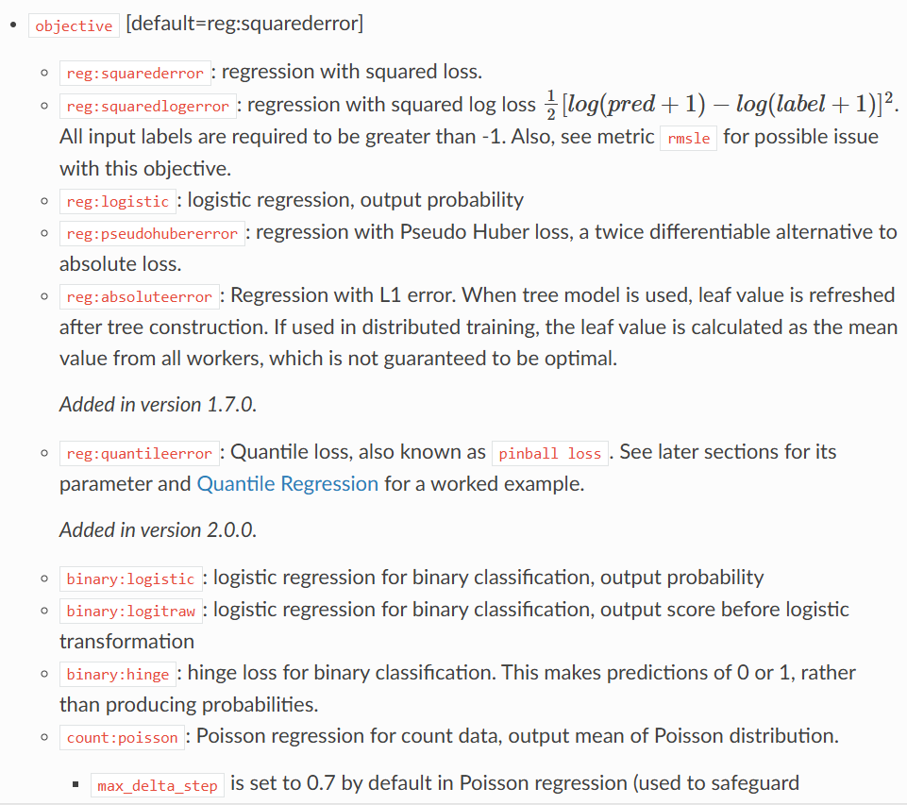
Objectives
Method
Environment Setup
Data loading
Train and Evaluation
Interpretability
Hyperparameters in XGBoost
Learning Task

Slide 30
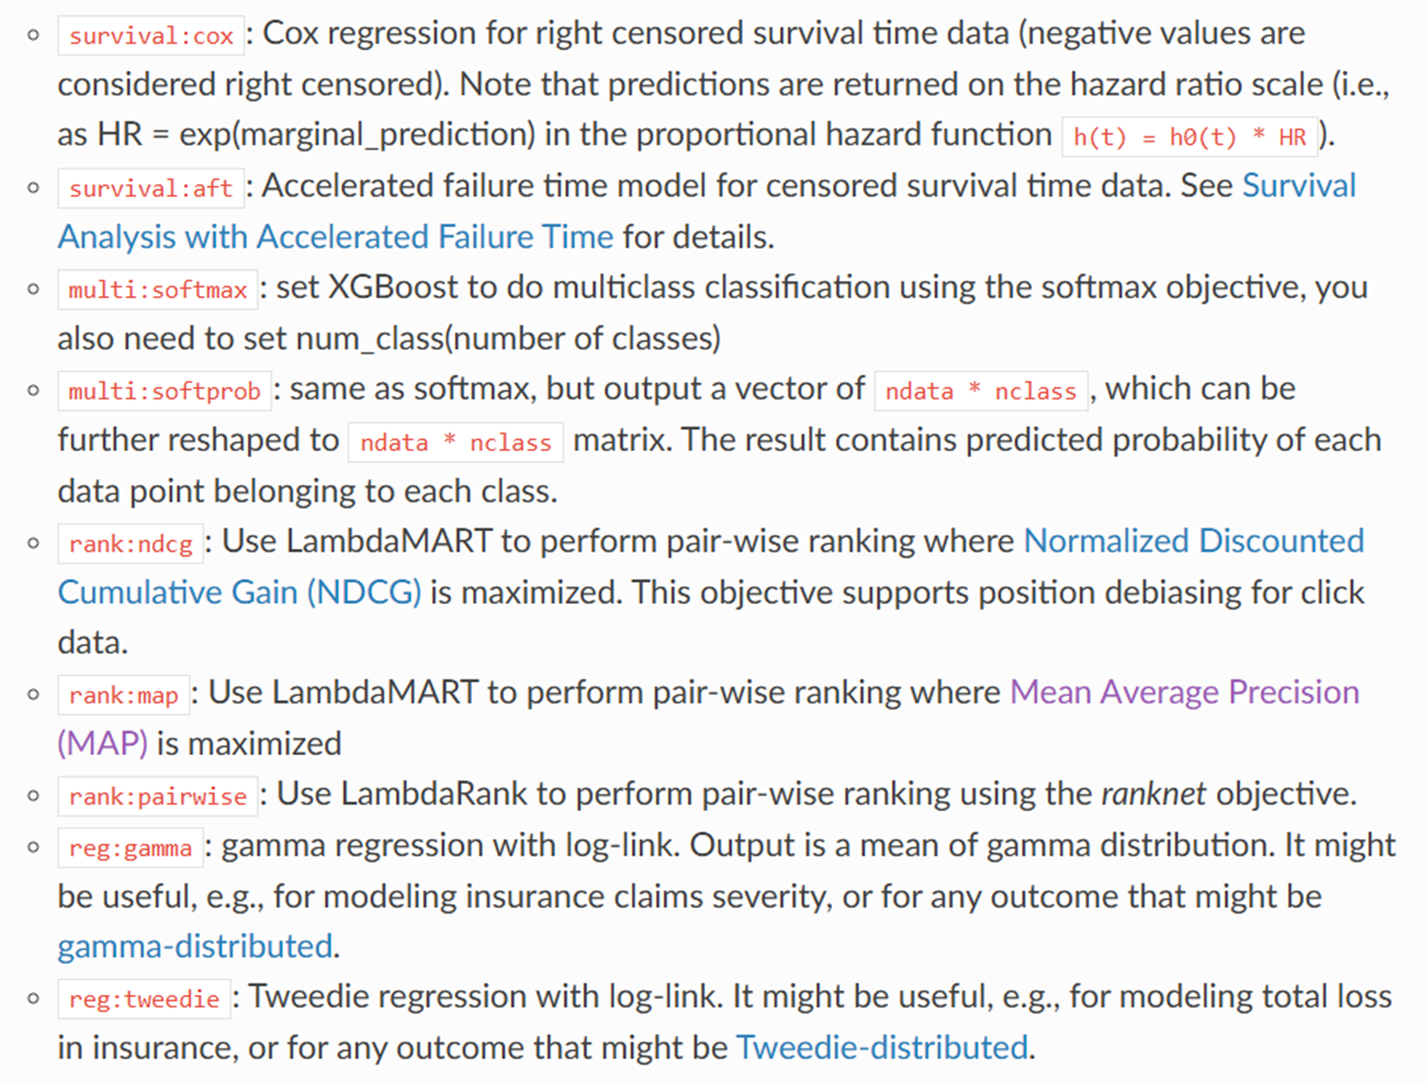
Objectives
Method
Environment Setup
Data loading
Train and Evaluation
Interpretability
Hyperparameters in XGBoost
Learning Task

Slide 31
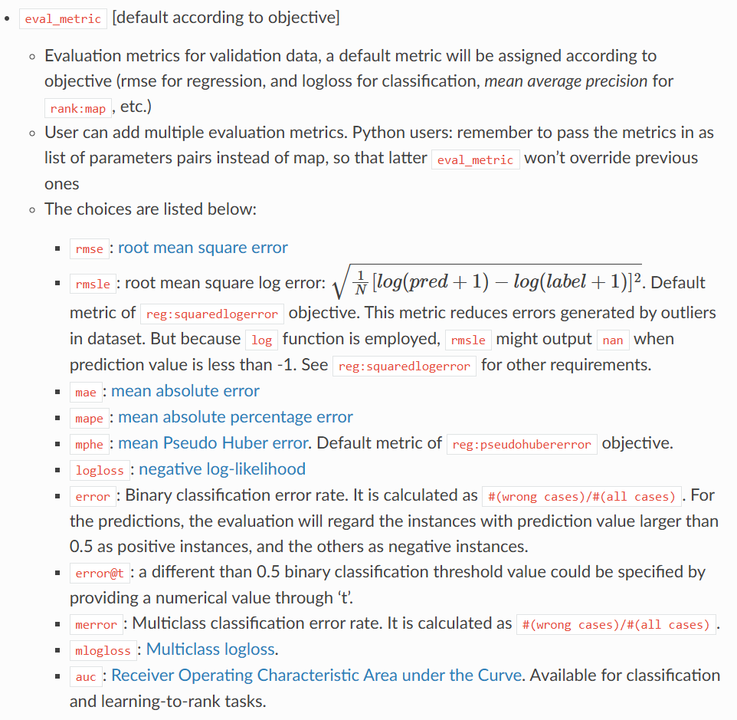
Objectives
Method
Environment Setup
Data loading
Train and Evaluation
Interpretability
Hyperparameters in XGBoost
Learning Task

Slide 32
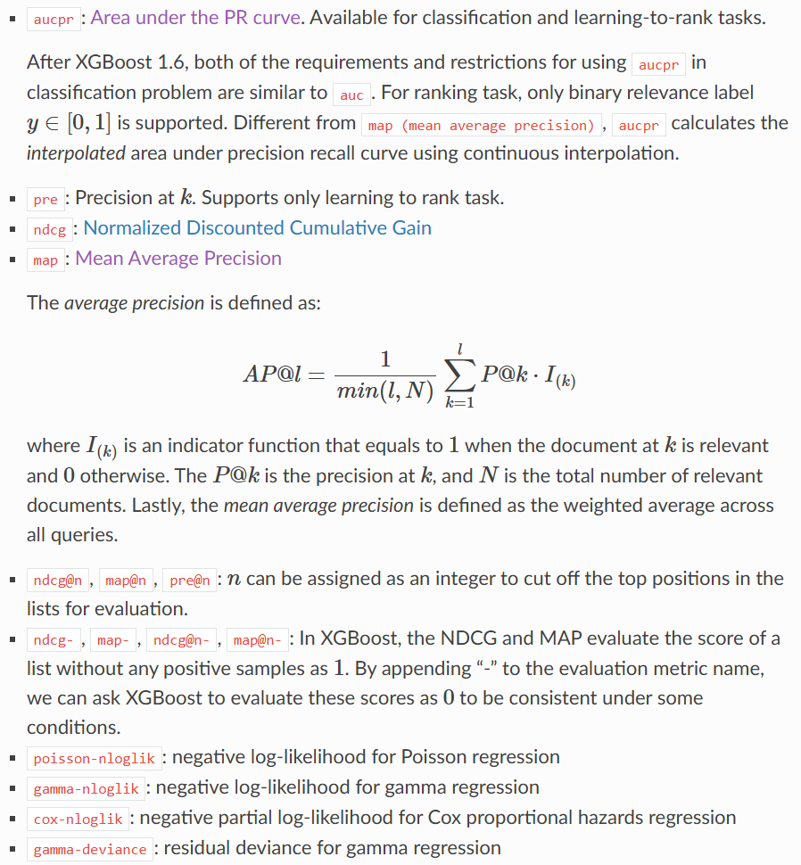
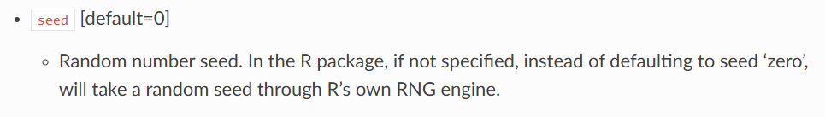
Objectives
Method
Environment Setup
Data loading
Train and Evaluation
Interpretability
Hyperparameters in XGBoost
Learning Task

Slide 33
Objectives
Method
Environment Setup
Data loading
Train and Evaluation
Interpretability
Hyperparameters in XGBoost
Hyperparameters
General
Booster
Learning Task
Command Line

Slide 34
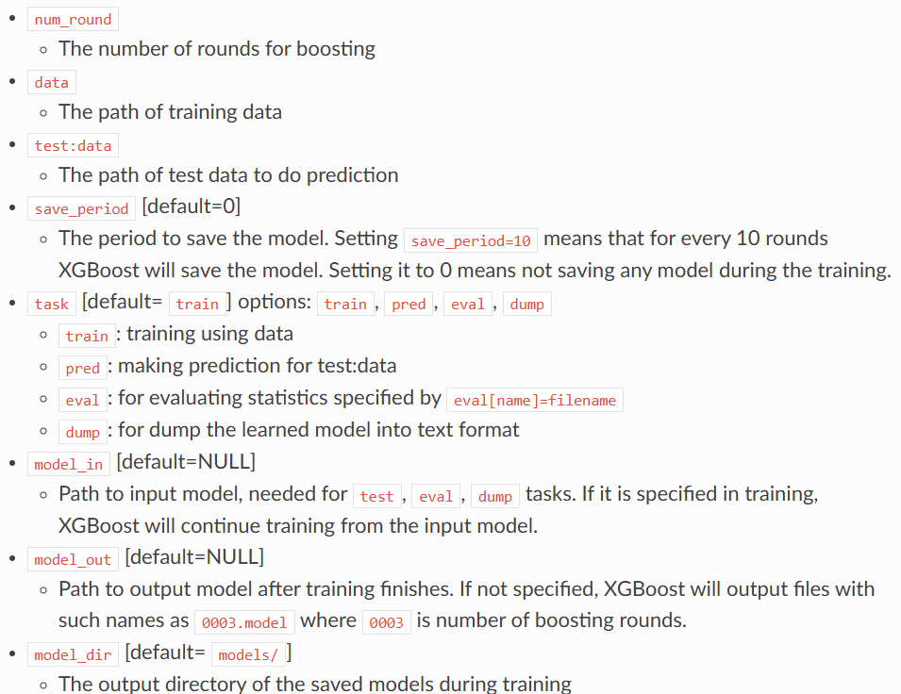
Objectives
Method
Environment Setup
Data loading
Train and Evaluation
Interpretability
Hyperparameters in XGBoost
Command Line

Slide 35
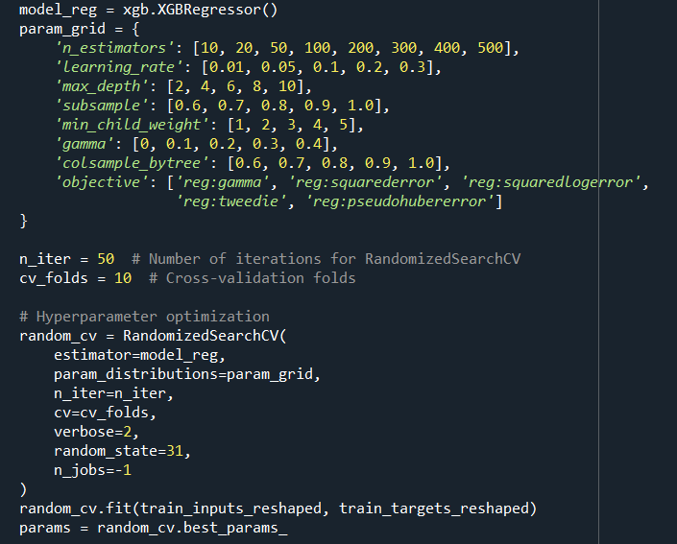
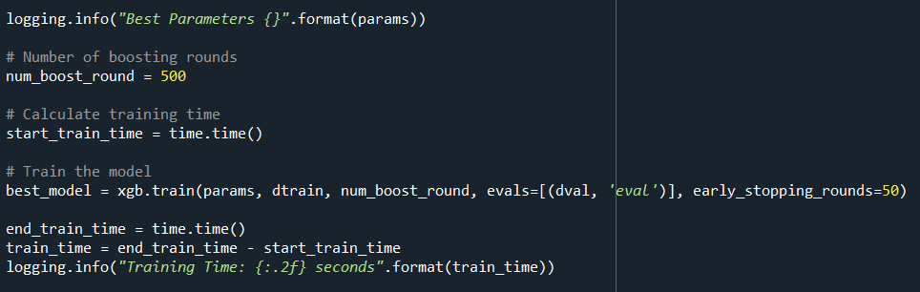
Objectives
Method
Environment Setup
Data loading
Train and Evaluation
Interpretability
Hyperparameters in XGBoost

Slide 36
Objectives
Method
Environment Setup
Data loading
Train and Evaluation
Interpretability
Downloading data from repository
📓 6. Use Jupyter Notebook
In the conda environment go to the project directory using: cd “project directory”
Type “jupyter lab”
Open the 01_Data_Acquisition_and_Loading.ipynb notebook
Validation
Train
Test
2018 and 2022
2023
2024

